Slide 1
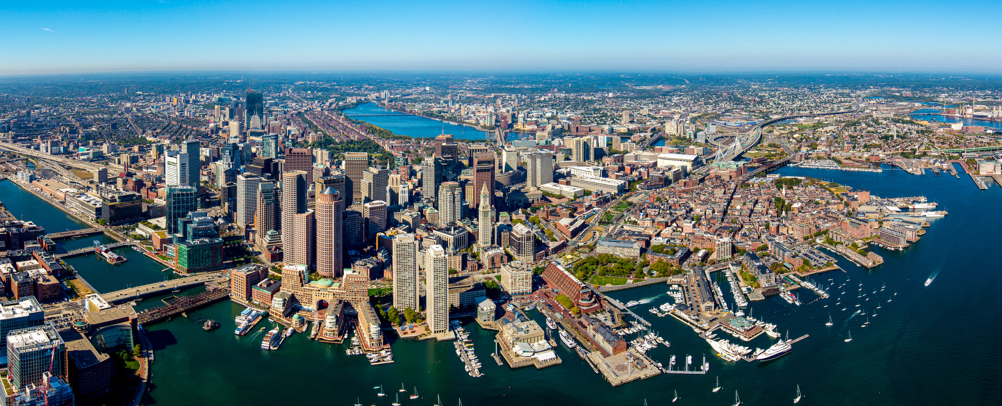
Global Coffee Value Chain Sustainability
From farm to cup: risks, impacts, and actions to decarbonize, protect livelihoods, and meet rising consumer expectations.

